Slide 1




FINAL
PROJECT
PRESENTATION
Subject: Data collection and reprocessing
Instructor: Master. Nguyen Son Lam
Group 07

Slide 2

Topic:
“Analysis data about transactions on Top Up_Momo in 2020”

Slide 3





Team members:
Le Vuong Duy
Nguyen Quoc Bao
Do Quoc Loc

Slide 4


Contents in the presentation
I. The introduction of topic: Showing information provided by the topic and requirements that the topic asks
II. Carrying out the topic and achieved results: Doing data reprocessing and tasks in Part A, Part B belonging to the Requirements asked by the topic
III. Conclusions and learnt lessons: Answering questions in Part C of the Requirements asked by the topic

Slide 5
I. The introduction of topic
Mobile Topup (Topup service) is one of MoMo's most important services with a large proportion of users and revenue. Topup service on the MoMo app is displayed under two icons: 'Nạp tiền điện thoại' and 'Mua mã thẻ di động'.

Slide 6
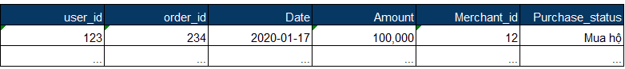
Provided Information
Transactions
Schema:
User_id: each user in MoMo will be given a unique id
Order_id: each transaction will be given a unique id
Date: date when the transaction took place
Amount: amount of money that user spent on that transaction (VND)
Merchant_id: each merchant will be given a unique id
Purchase_status: if the user uses the account to buy a card for another user, it will be labeled 'Mua hộ'

Slide 7
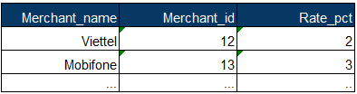
Commission
Schema:
Merchant_name: name of Telco
Merchant_id: each merchant will be given a unique id
Rate_pct: commission percentage (%) that MoMo earns from the merchant for each transaction amount

Slide 8
User_Info
Schema:
User_id: each user in MoMo will be given an unique id
First_tran_date: the first day of using Topup service
Gender: Male/Female
Age: user's age has been divided into groups
Location: user's location on the ID card

Slide 9
2. Requirements
Part A: Data Processing
Using data from the 'Commission' table, add a column 'Revenue' in the 'Transactions' table that displays MoMo's earned revenue for each order, and then calculate MoMo's total revenue in January 2020.
What is MoMo's most profitable month?
What day of the week does MoMo make the most money, on average? The least money?
Combined with the 'User_Info' table, add columns: Age, Gender, Location, Type_user (New/Current) in 'Transactions' table and calculate the total number of new users in July 2020.
Part B: Data Visualization
5. Design a performance-tracking dashboard of this service by month, tracking a variety of metrics that you think might be helpful to the business.

Slide 10
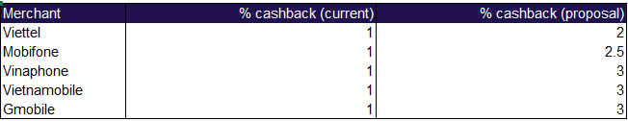
Part C: Analysis & Business Insights
6. Based on the provided data, what observations and insights can you draw about user demographics and transaction behavior (e.g. trends, classifications)?
7. Do you have any advice for the Marketing department in designing promotion campaigns to increase Topup's monthly performance?
8. Momo is facing stiff competition from a host of other e-wallets that have deep mobile card cashback schemes for users. In response, MoMo is considering deducting a part of revenue to increase cashback for users in all Telco merchants.
Suppose that users currently earn a flat 1% cash-back on their spending amount. The proposed change is as follows:
How does this affect the service (Comment from many perspectives)? Do you agree with this option?
9. What other Topup development strategy ideas do you have for MoMo?

Slide 11
II. Carrying out the topic and achieved results
Data Reprocessing
Carrying out requirements asked by the topic
Appling Linear Regression Model to train and predict on Revenue column

Slide 12
Data Reprocessing

Slide 13
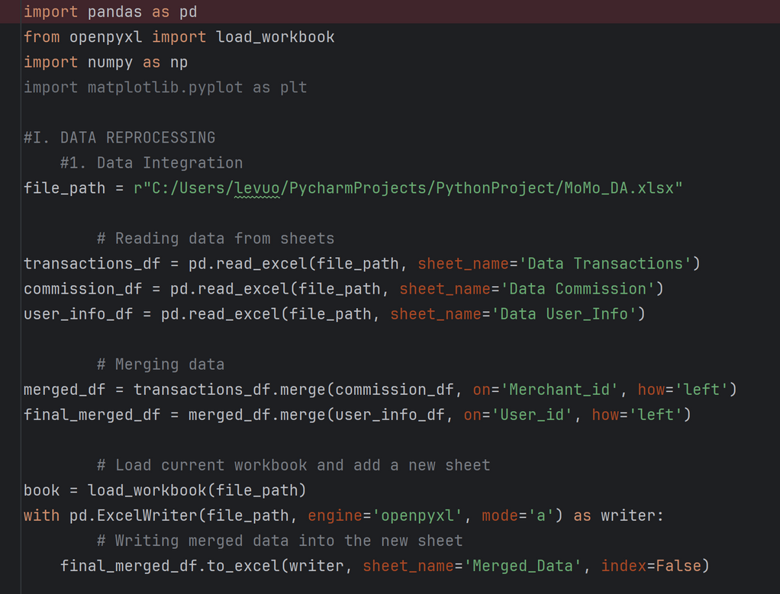
DATA REPROCESSING
Data Integration: Merging 3 datasets in the tabs "Data Transactions", "Data Commission", "Data User_Info" together

Slide 14
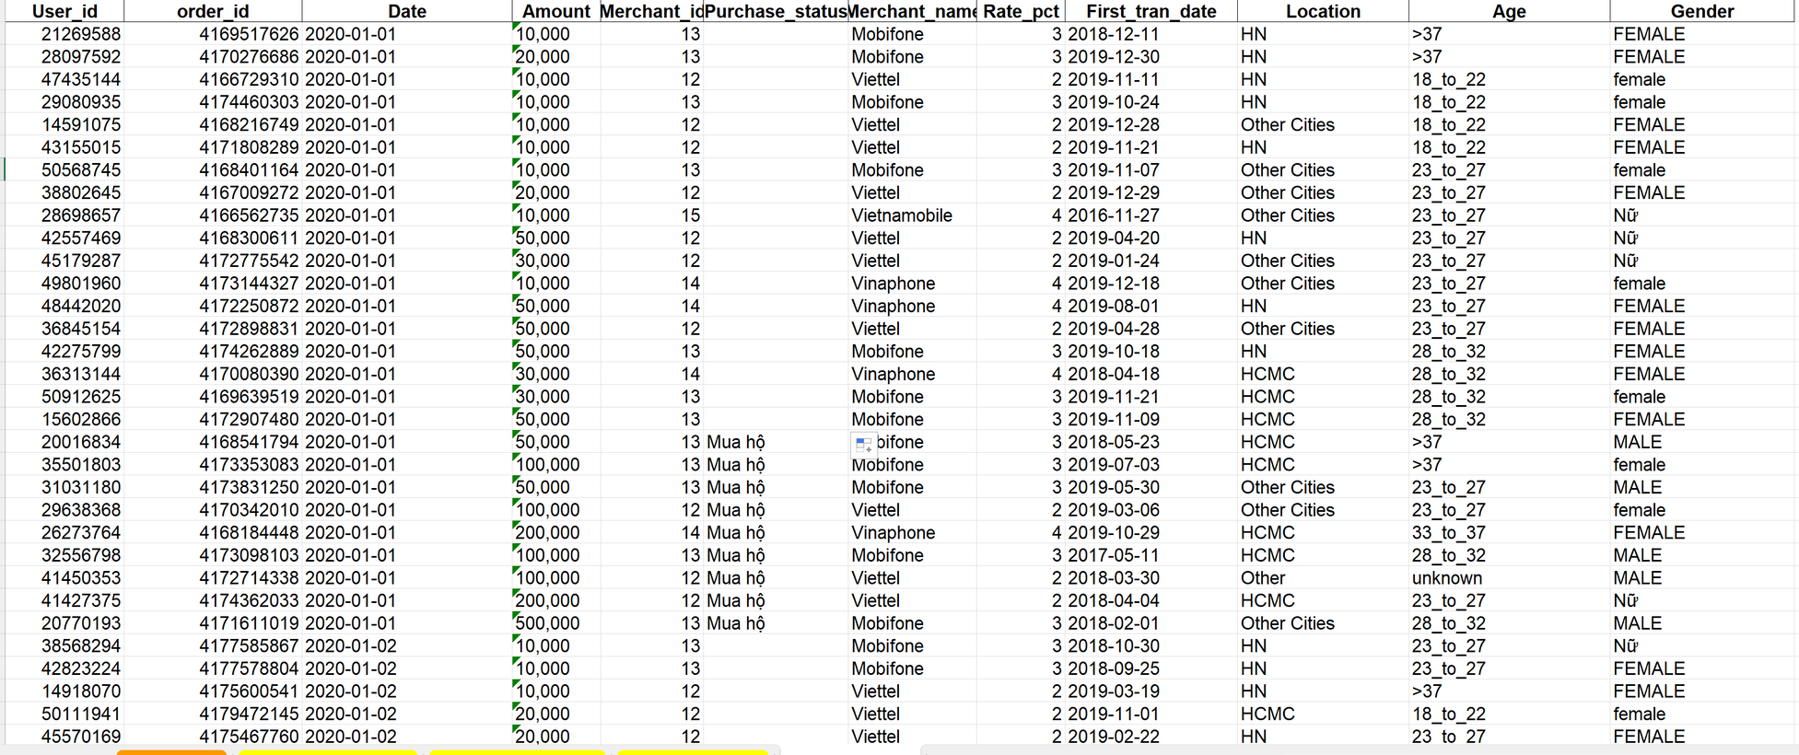
DATA REPROCESSING
=> RESULT:

Slide 15
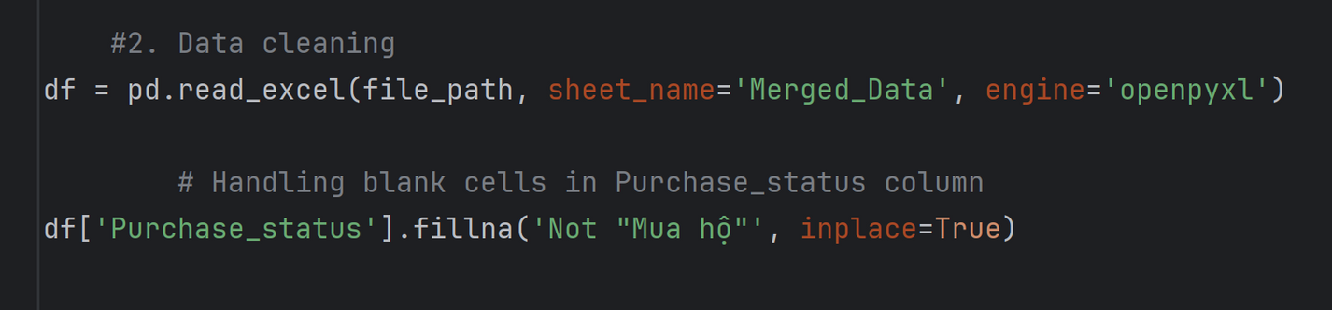
DATA REPROCESSING
Cleaning data: Handling cells with missing data, outliers, and inconsistent values
Handling cells with missing data in ‘Purchase_status’ column
Add the value of Not “Mua hộ” of the cells that miss the data

Slide 16
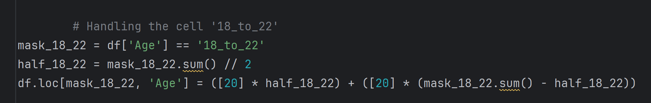
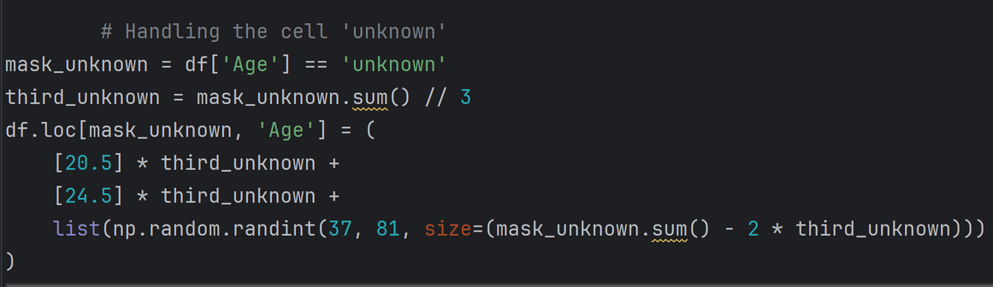
DATA REPROCESSING
Cleaning data: Handling cells with missing data, outliers, and inconsistent values
Handling cells with outliers in ‘Age’ column
Assign random age value corresponding range of that cell

Slide 17
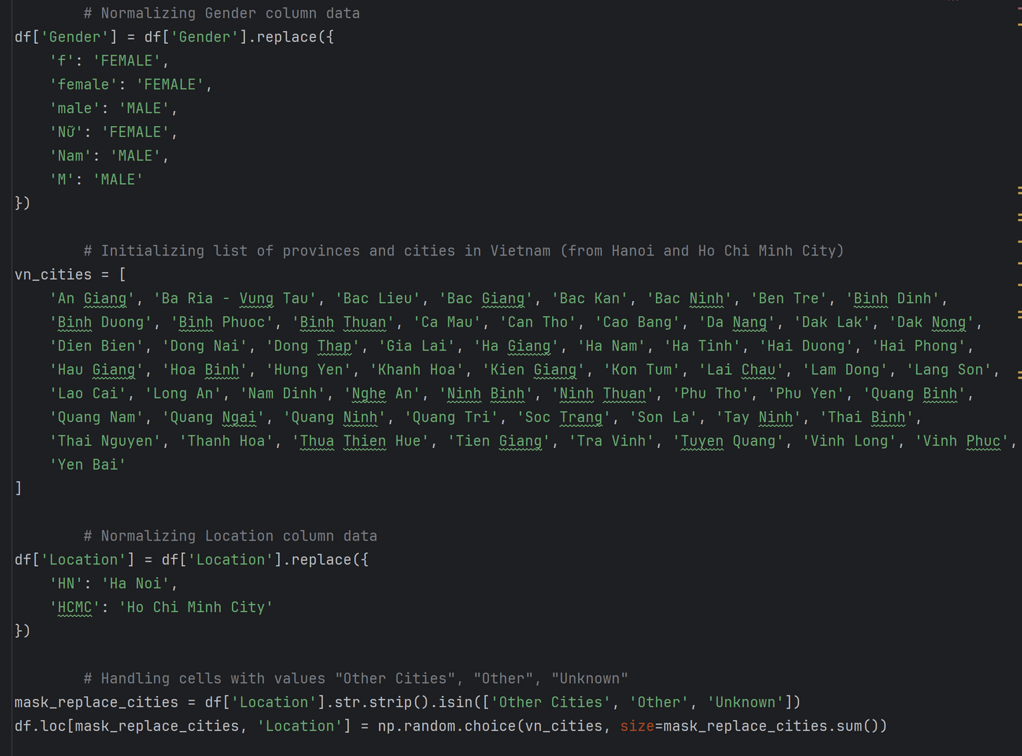
DATA REPROCESSING
Handling cells with inconsistent data in ‘Location’ and ‘Gender’ column
Fill in the cells with the value of ‘Other Cities’ 1 random value in the list of provinces and cities in VN except HN and HCMC

Slide 18
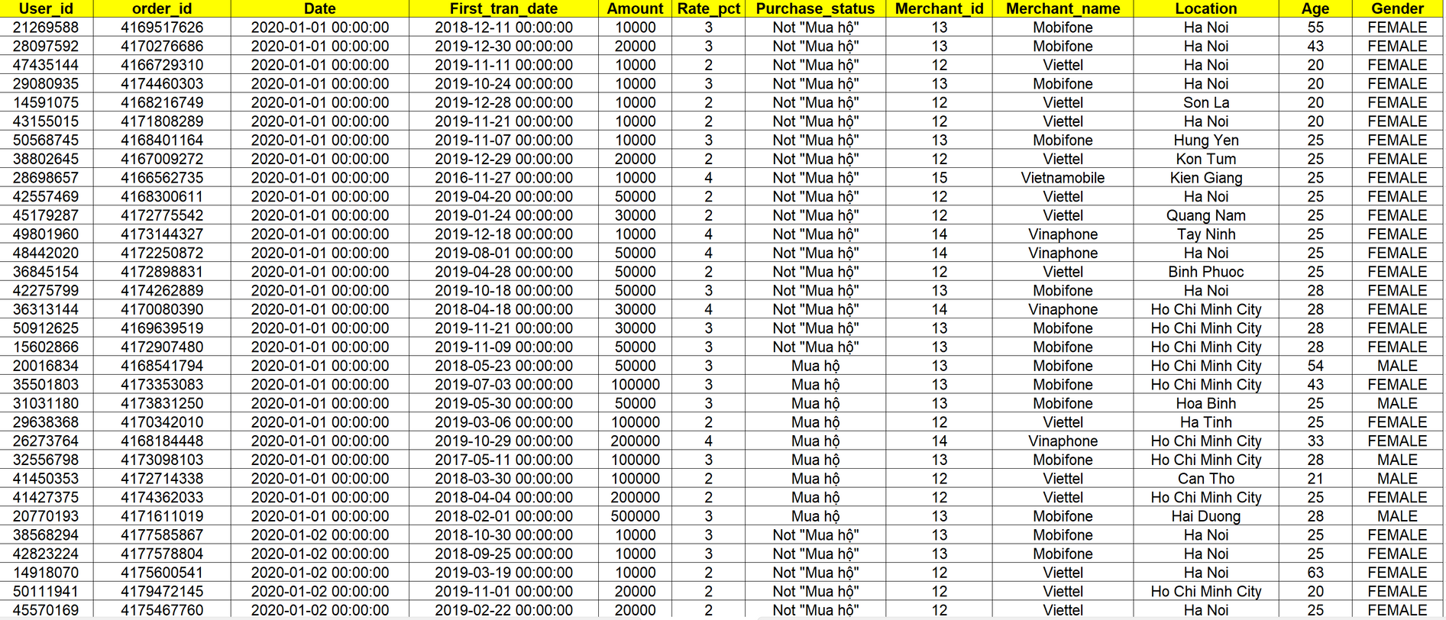
DATA REPROCESSING
=> RESULT:

Slide 19
2. Carrying out requirements asked by the topic

Slide 20
Part A: Data Processing

Slide 21

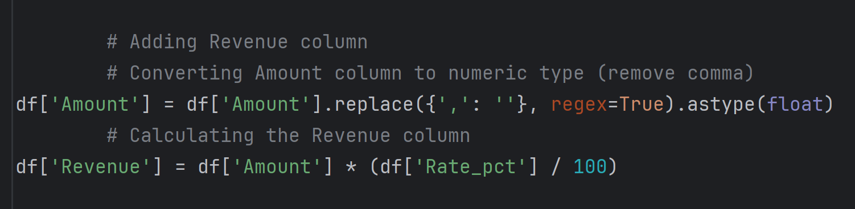
Carrying out requirements asked by the topic
Part A:
ADDING “REVENUE” COLUMN

Slide 22
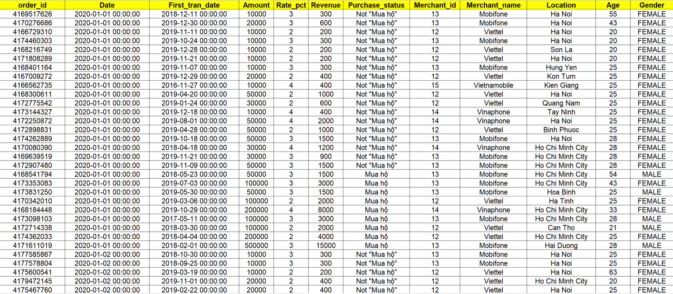
Carrying out requirements asked by the topic
Part A:
ADDING “REVENUE” COLUMN
=> RESULT:

Slide 23
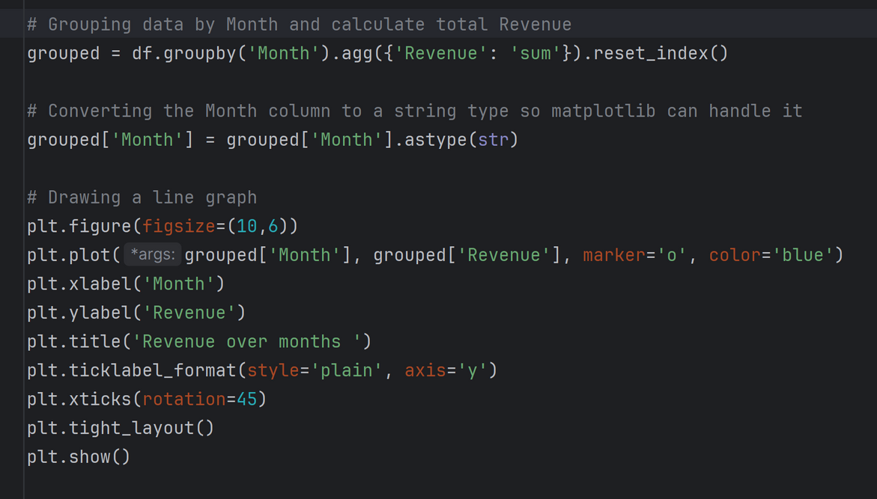
Carrying out requirements asked by the topic
Part A:
Calculating January revenue and find the month with the highest revenue

Slide 24
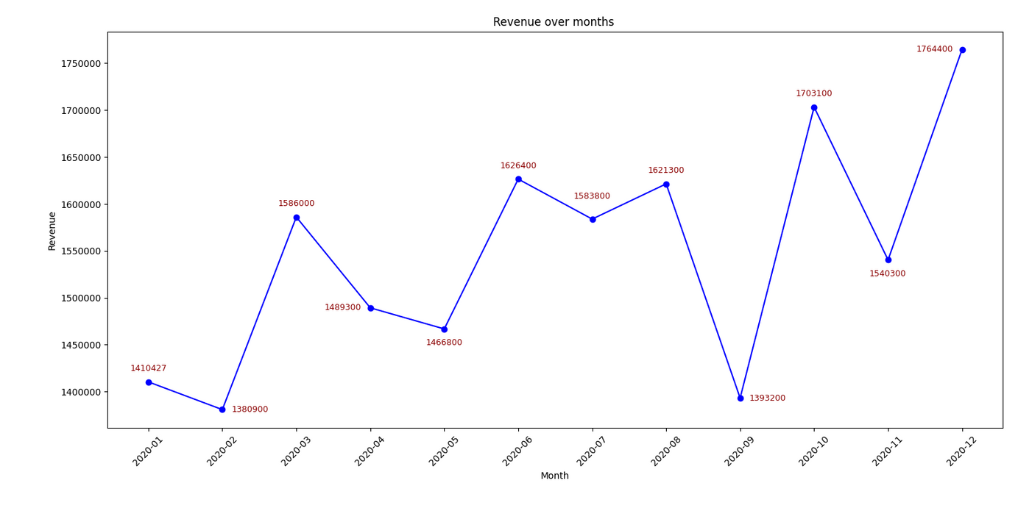
Carrying out requirements asked by the topic
Part A:
=> RESULT:
Calculating January revenue and find the month with the highest revenue

Slide 25
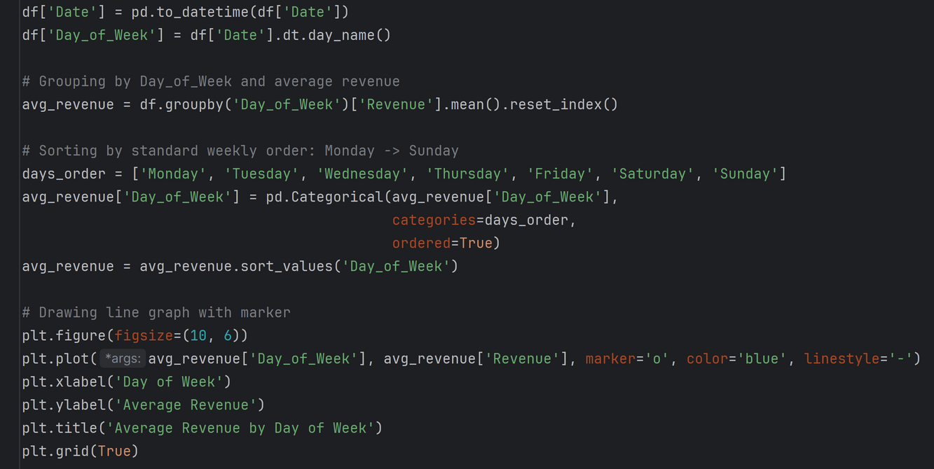
Carrying out requirements asked by the topic
Part A:
Adding “Day of Week” column and finding out the dayweek with the highest and lowest average revenue

Slide 26
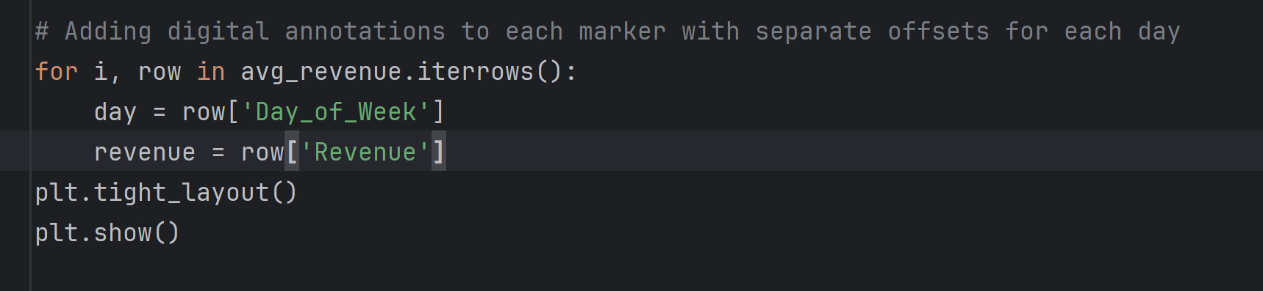
Carrying out requirements asked by the topic
Part A:
Adding “Day of Week” column Finding out the month with the highest and lowest average revenue

Slide 27
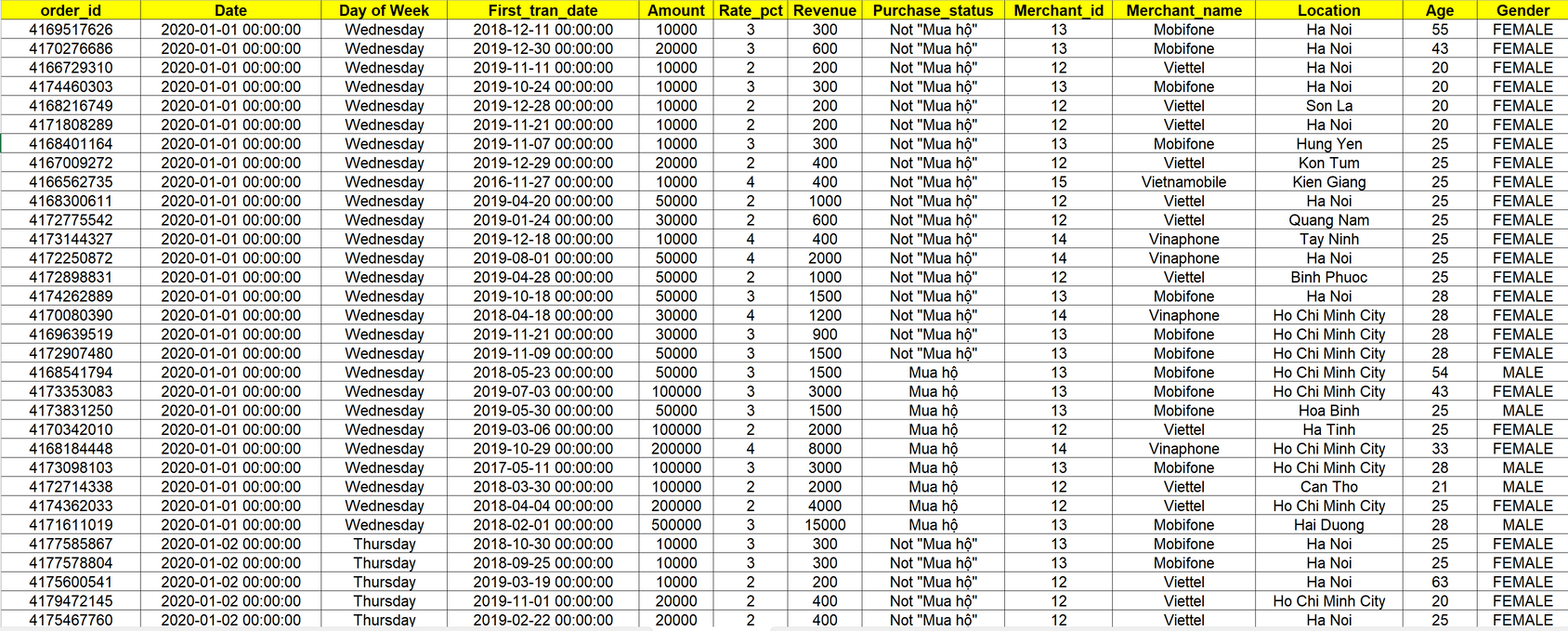
Carrying out requirements asked by the topic
Part A:
Adding “Day of Week” column Finding out the month with the highest and lowest average revenue
=> RESULT:

Slide 28
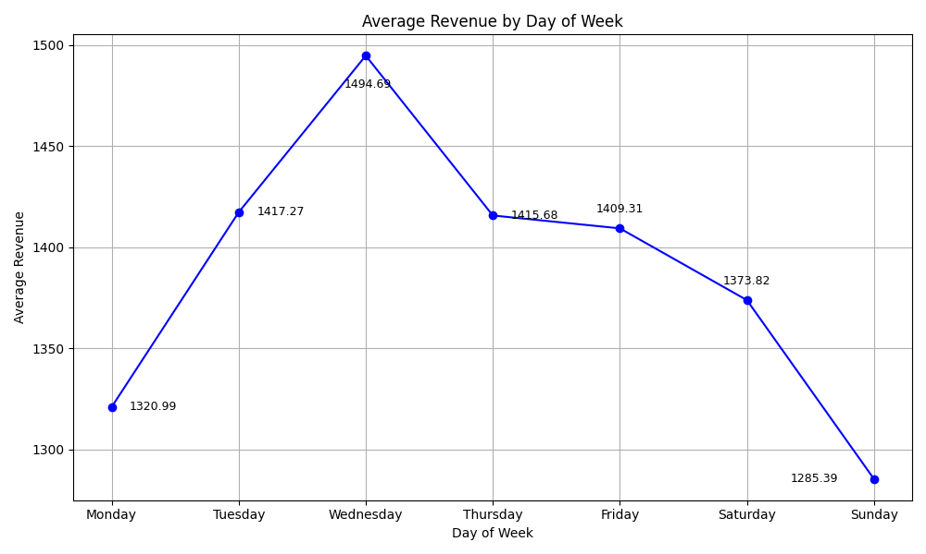
Carrying out requirements asked by the topic
Part A:
Adding “Day of Week” column Finding out the month with the highest and lowest average revenue
=> RESULT:

Slide 29
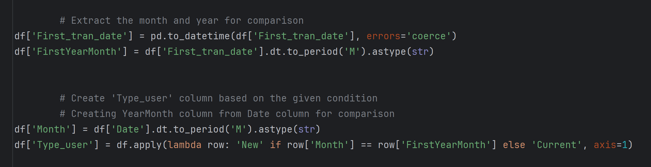
Carrying out requirements asked by the topic
Part A:
Adding “Type_User” column

Slide 30
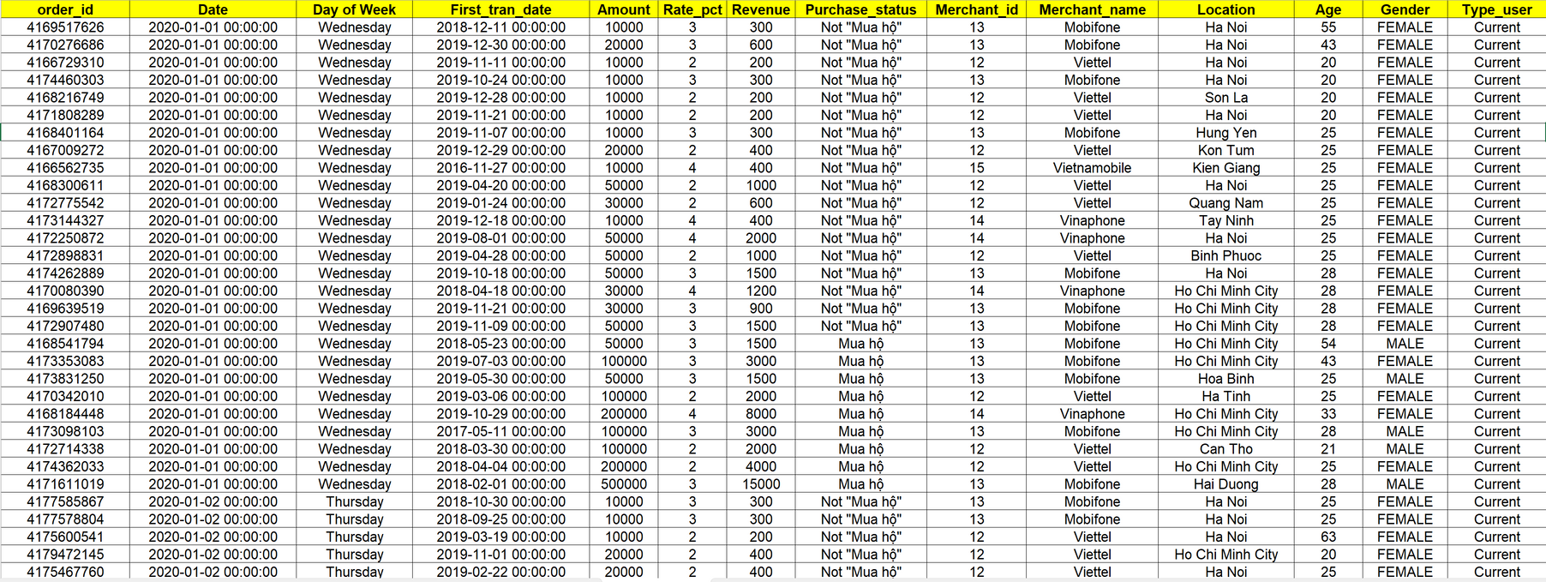
Carrying out requirements asked by the topic
Part A:
Adding “Type_User” column
=> RESULT:

Slide 31
Part B: Data Visualization

Slide 32
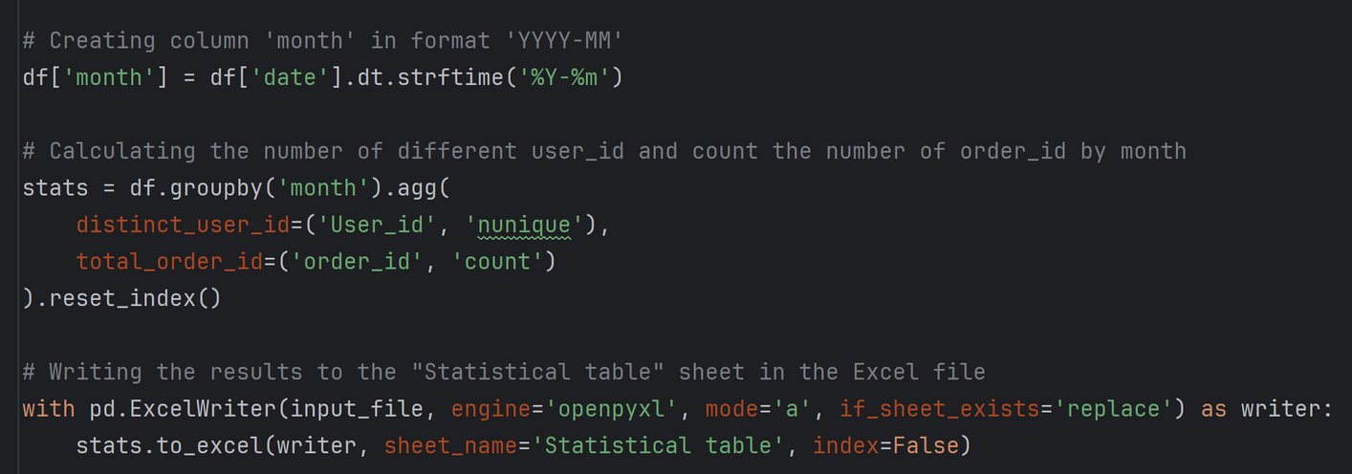
Carrying out requirements asked by the topic
Part B: Data Visualization
Creating a table of statistics on the number of users and the number of transactions over the months

Slide 33
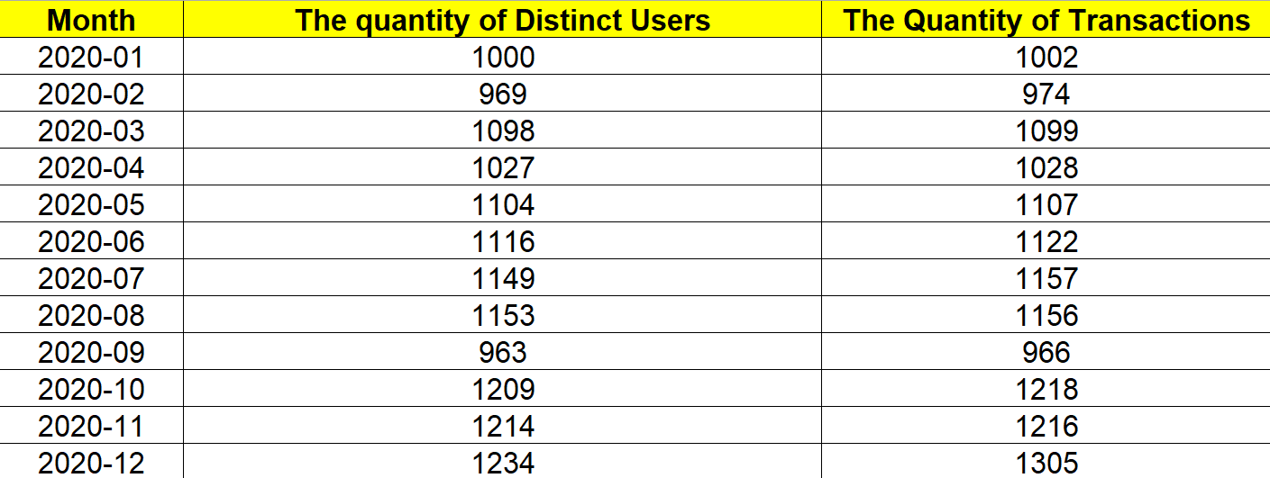
Carrying out requirements asked by the topic
Part B: Data Visualization
Creating a table of statistics on the number of users and the number of transactions over the months
=> RESULT:

Slide 34
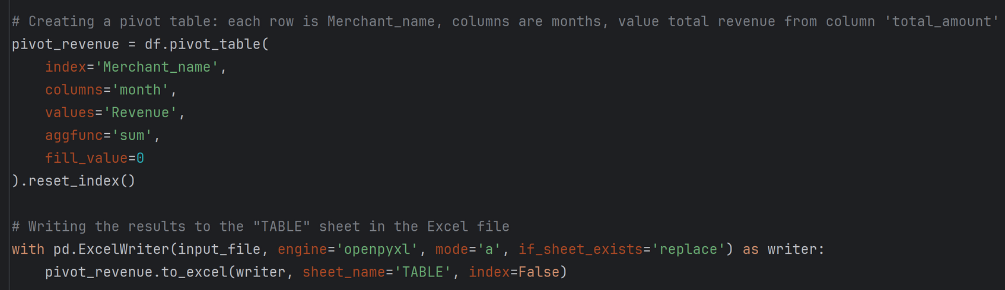
Carrying out requirements asked by the topic
Part B: Data Visualization
Creating a table of total revenue of Merchant_names over the months

Slide 35
Carrying out requirements asked by the topic
Part B: Data Visualization
Creating a table of total revenue of carriers over the months
=> RESULT:

Slide 36
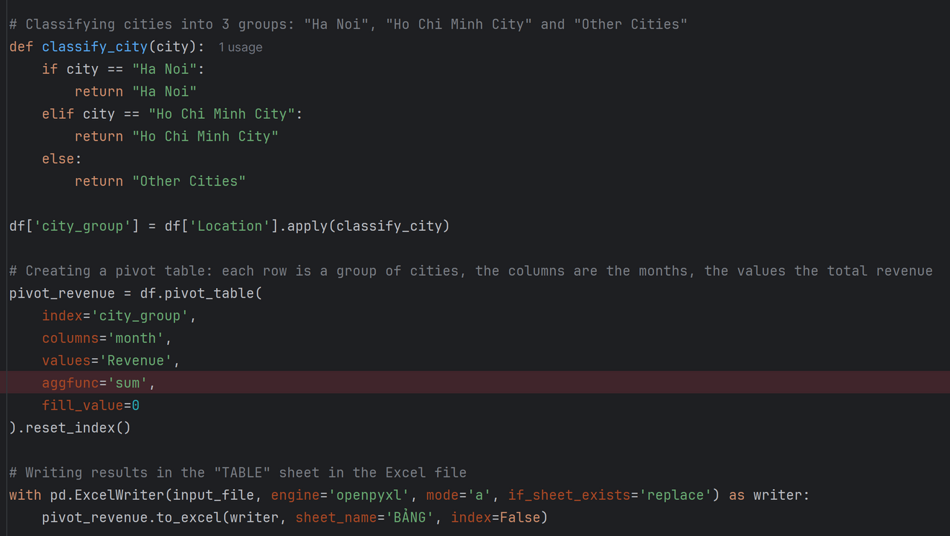
Carrying out requirements asked by the topic
Part B: Data Visualization
Create a table of total revenue of localities over the months

Slide 37
Carrying out requirements asked by the topic
Part B: Data Visualization
Create a table of total revenue of localities over the months
=> RESULT:

Slide 38
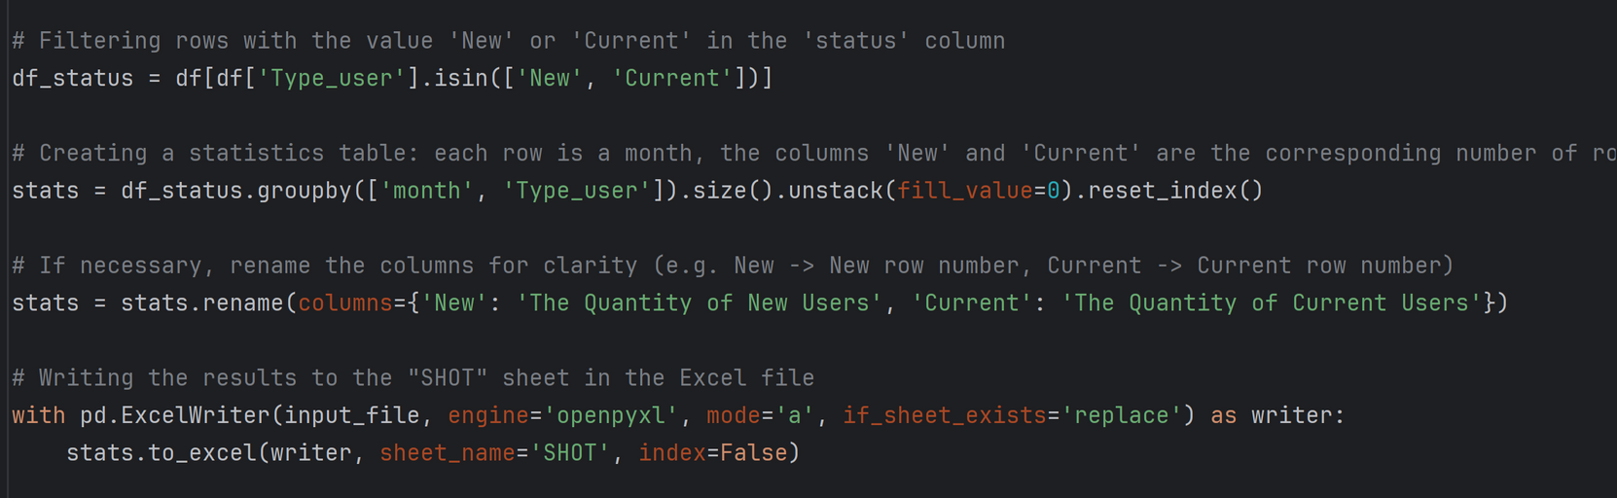
Carrying out requirements asked by the topic
Part B: Data Visualization
Creating a table of new and current users over the months

Slide 39
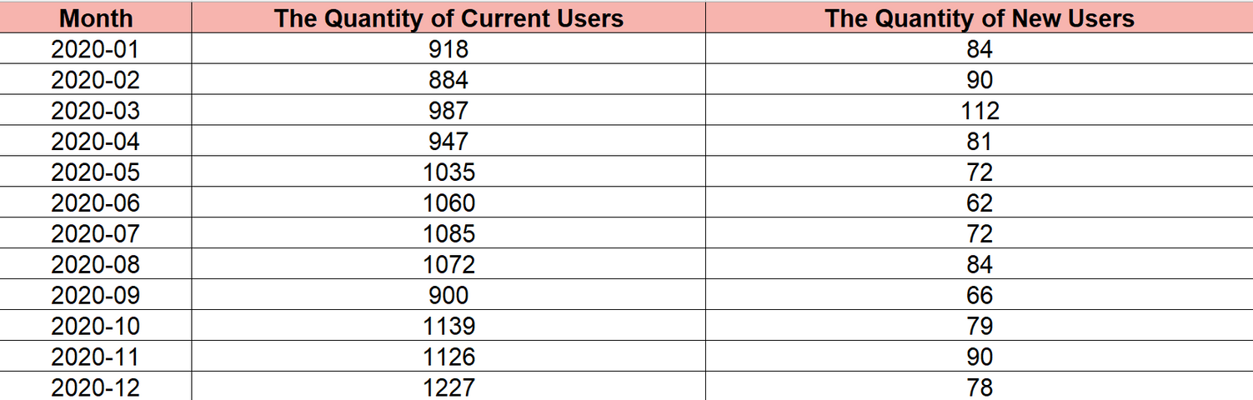
Carrying out requirements asked by the topic
Part B: Data Visualization
Creating a table of new and current users over the months
=> RESULT:

Slide 40
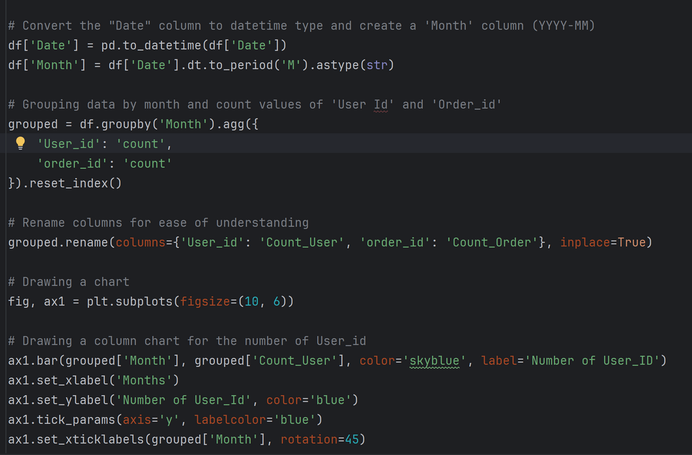
s
Carrying out requirements asked by the topic
Part B: Data Visualization
Drawing Bar chart with line combination showing total number of distinct users and transactions over months

Slide 41
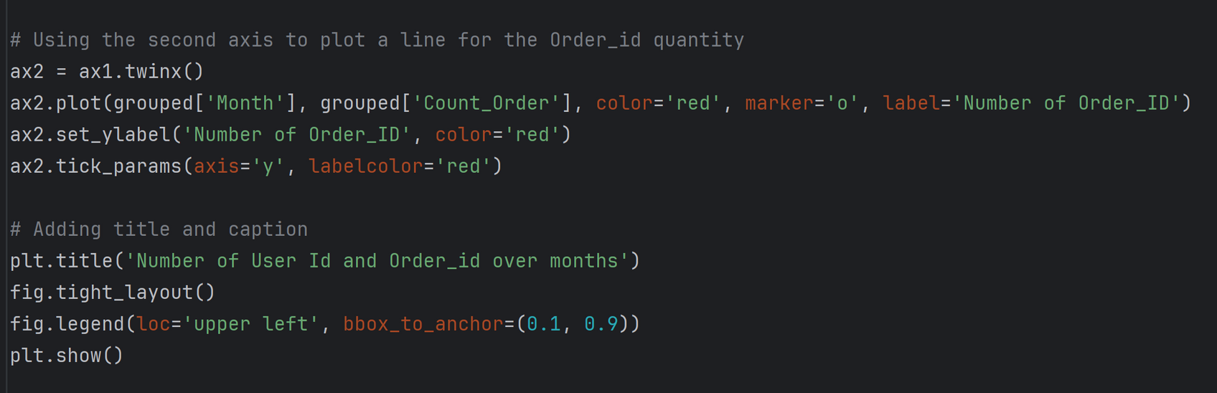
s
Carrying out requirements asked by the topic
Part B: Data Visualization
Drawing Bar chart with line combination showing total number of distinct users and transactions over months

Slide 42
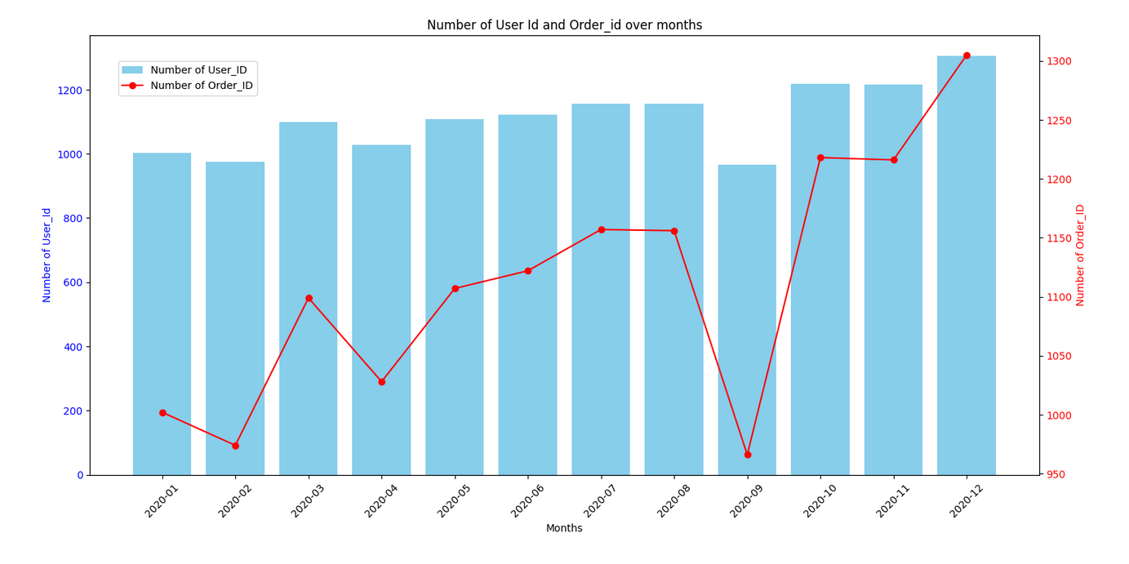
s
Carrying out requirements asked by the topic
Part B: Data Visualization
Drawing Bar chart with line combination showing total number of distinct users and transactions over months
=> RESULT:

Slide 43
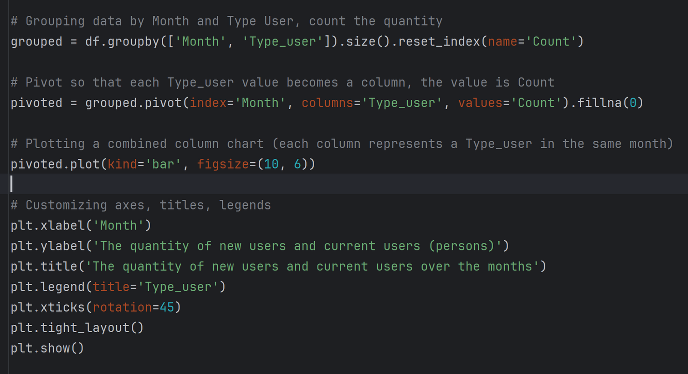
s
Part B: Data Visualization
Carrying out requirements in Excel file
Drawing a combined bar chart showing the number of new and returning users over the months

Slide 44
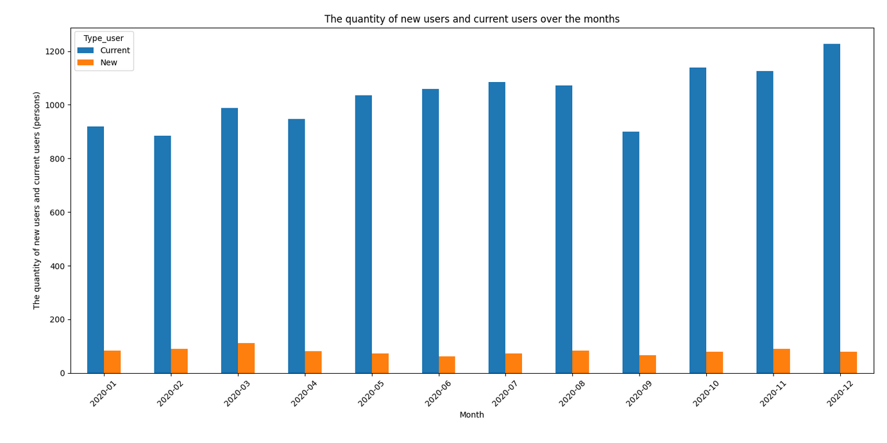
s
Carrying out requirements asked by the topic
Part B: Data Visualization
=> RESULT:
Drawing a combined bar chart showing the number of new and current users over the months

Slide 45
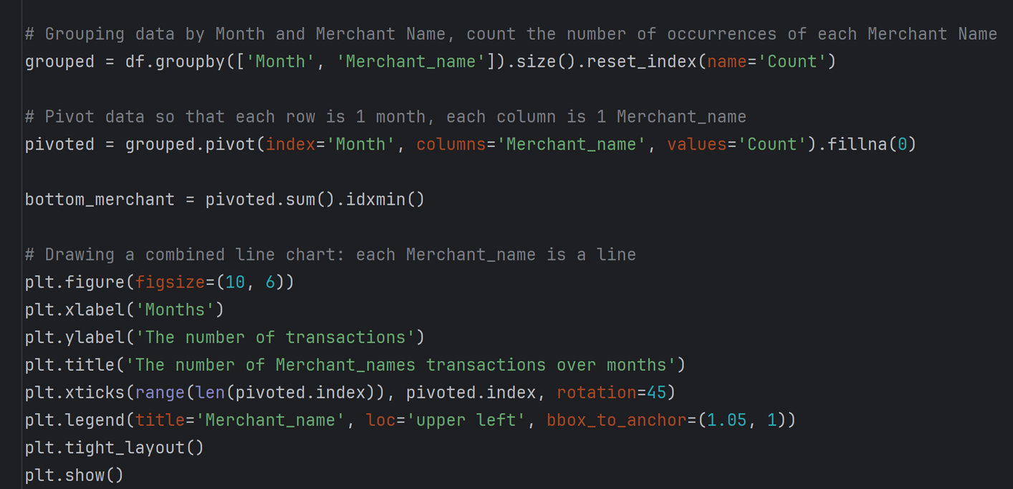
s
Part B: Data Visualization
Carrying out requirements asked by the topic
Drawing a combined line graph showing the number of transactions by Merchant_names over the months

Slide 46
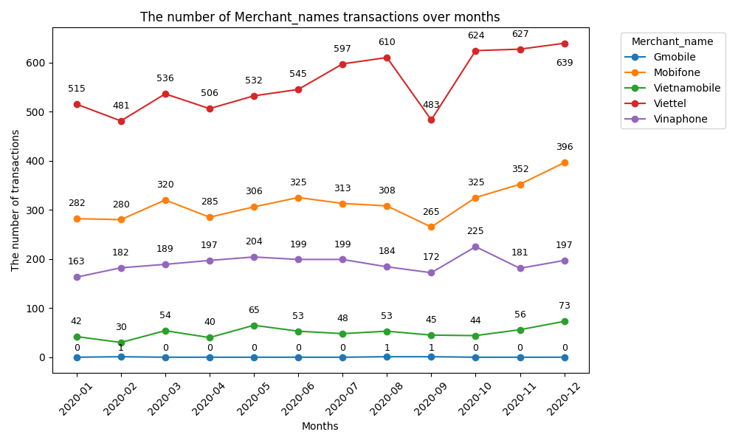
s
Carrying out requirements asked by the topic
Part B: Data Visualization
=> RESULT:
Drawing a combined line graph showing the number of transactions by Merchant_names over the months

Slide 47
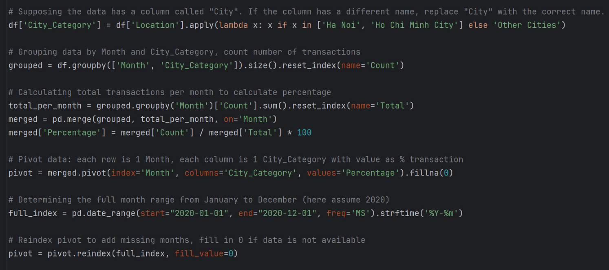
s
Carrying out requirements asked by the topic
Part B: Data Visualization
Drawing a combined area chart showing the percentage of places over the month

Slide 48
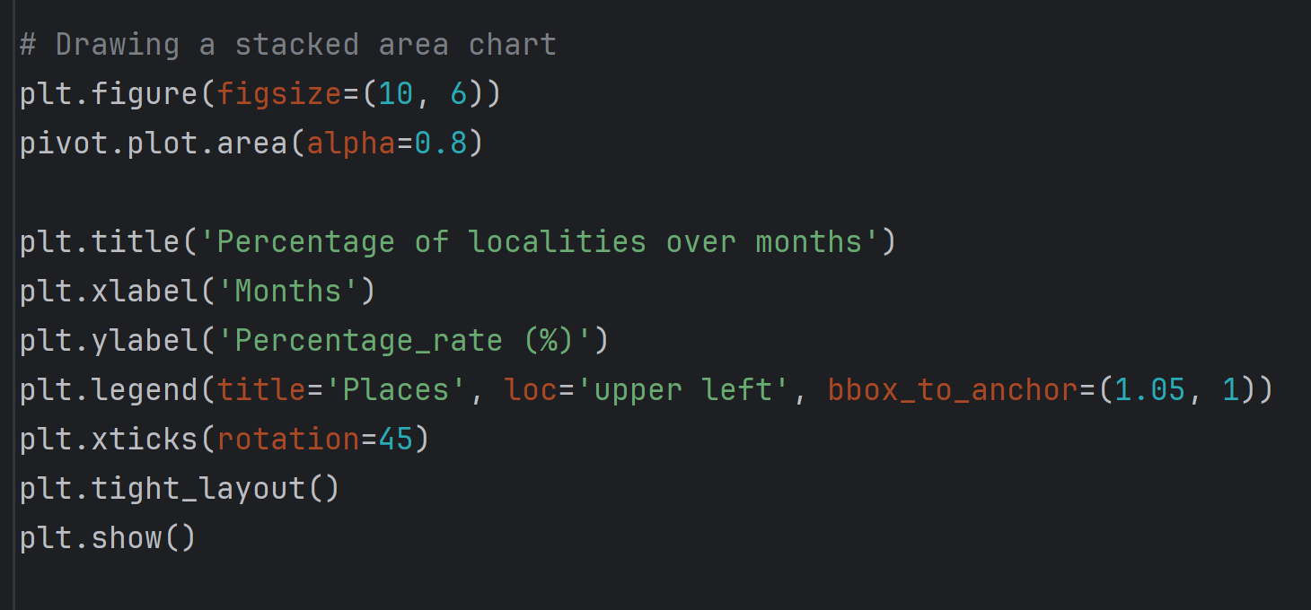
s
Carrying out requirements asked by the topic
Part B: Data Visualization
Drawing a combined area chart showing the percentage of places over the month

Slide 49
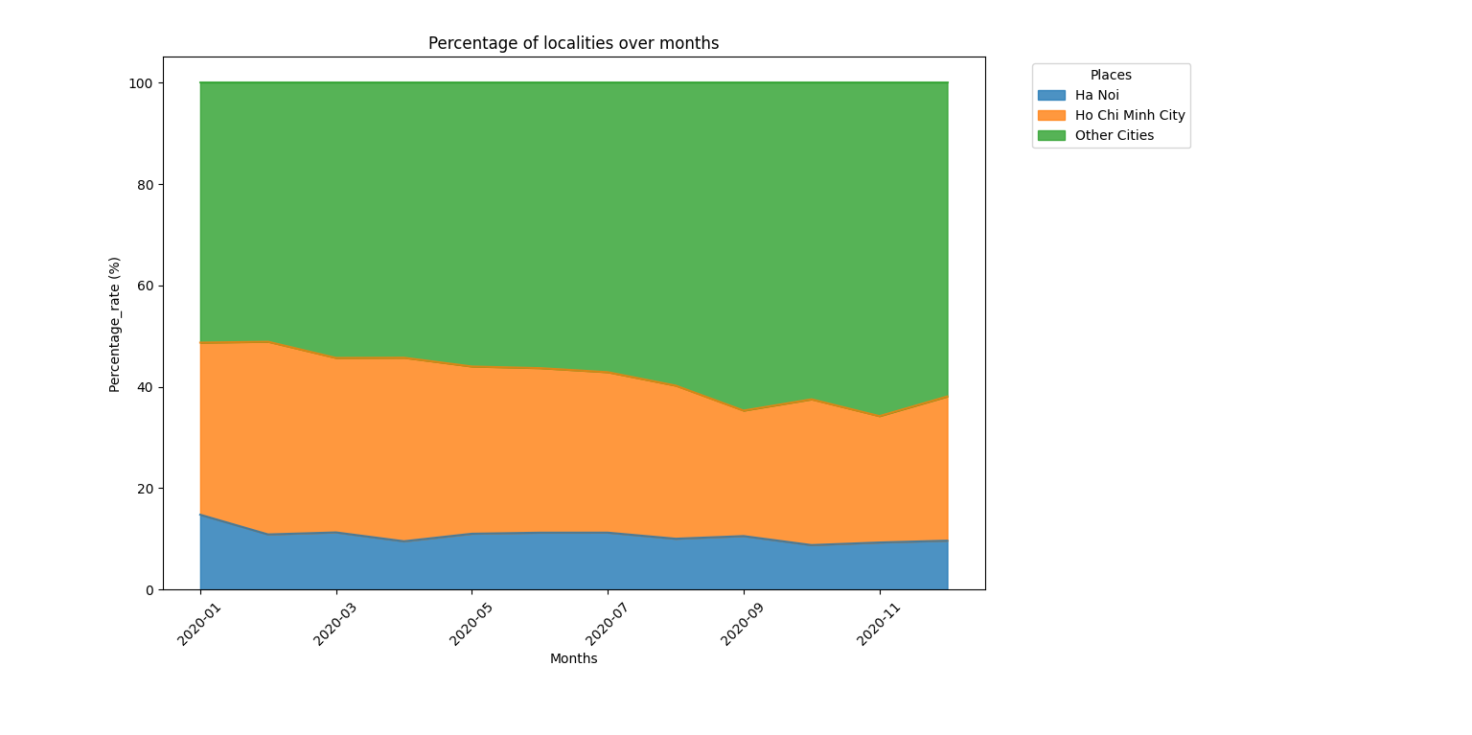
s
Part B: Data Visualization
Carrying out requirements asked by the topic
=> RESULT:
Drawing a combined area chart showing the percentage of places over the month

Slide 50
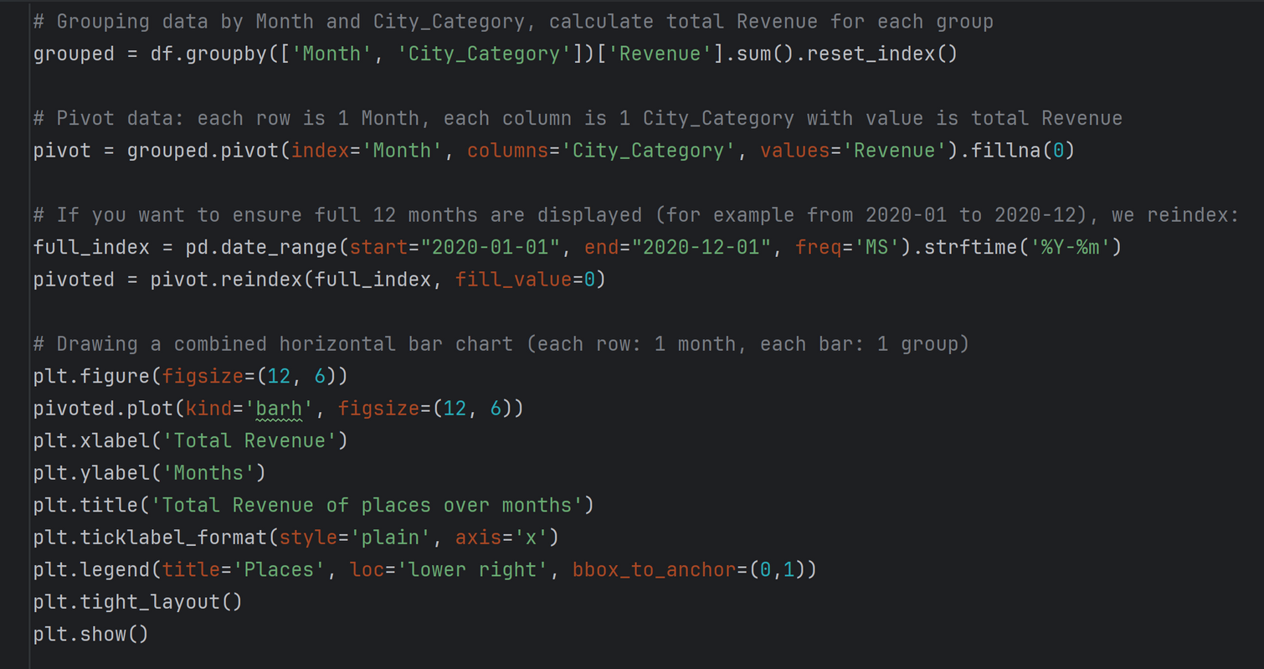
s
Carrying out requirements asked by the topic
Part B: Data Visualization
Drawing a horizontal bar chart showing total monthly sales by location

Slide 51
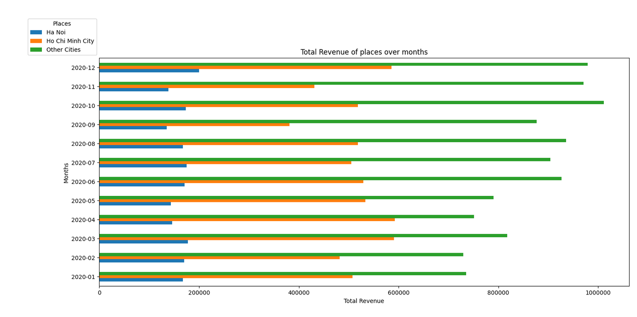
s
Carrying out requirements asked by the topic
Part B: Data Visualization
Drawing a horizontal bar chart showing total monthly sales by location
=> RESULT:

Slide 52
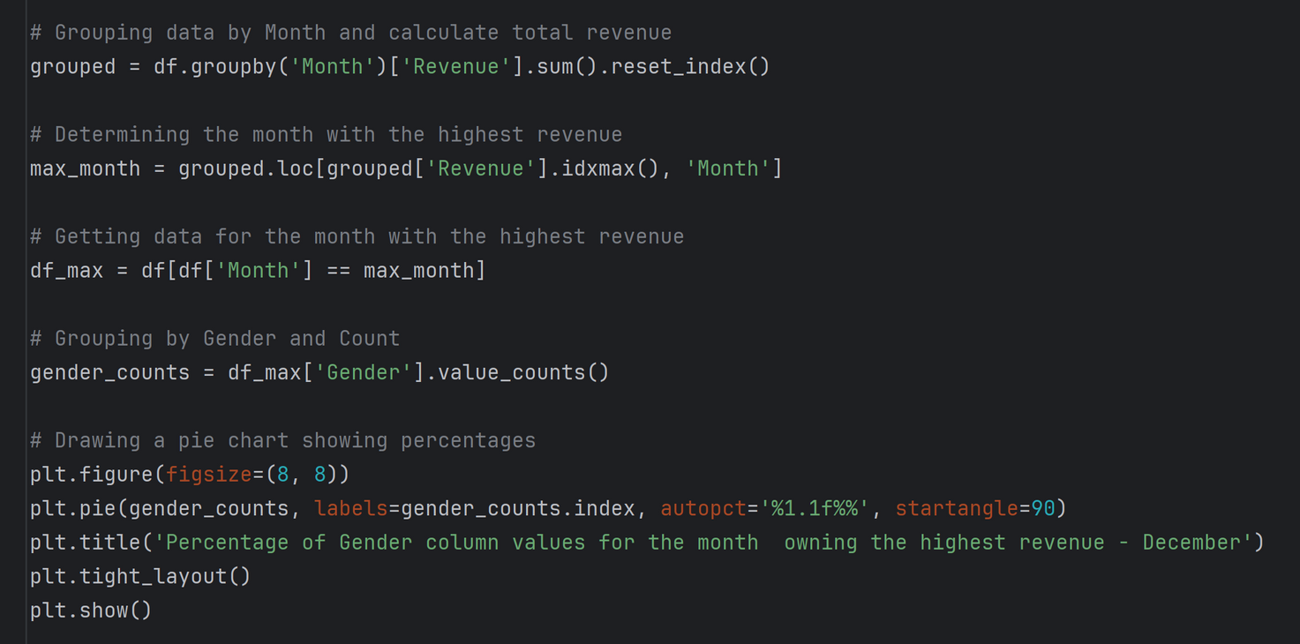
s
Carrying out requirements asked by the topic
Part B: Data Visualization
Drawing a pie chart showing the gender percentage of traders in the month with the highest revenue-December

Slide 53
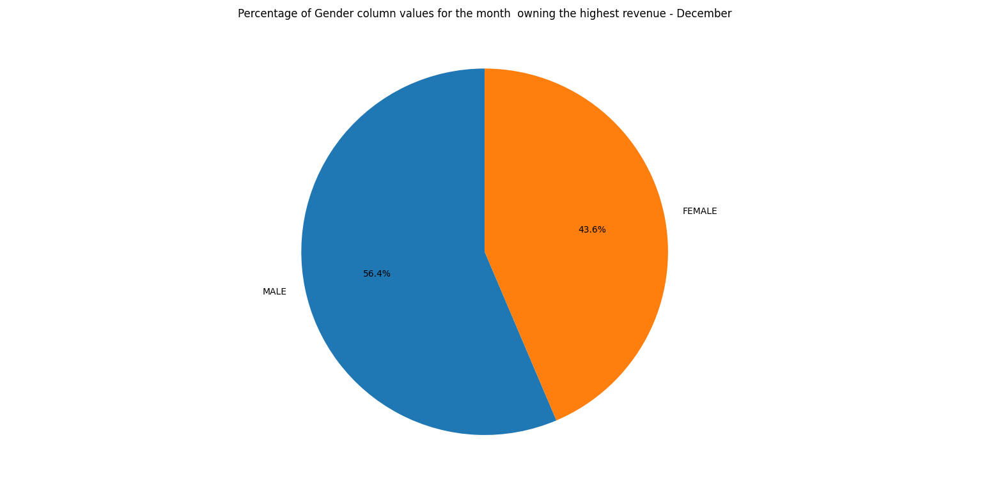
s
Carrying out requirements asked by the topic
Part B: Data Visualization
Draw a pie chart showing the gender percentage of traders in the month with the highest revenue
-December
=> RESULT:

Slide 54
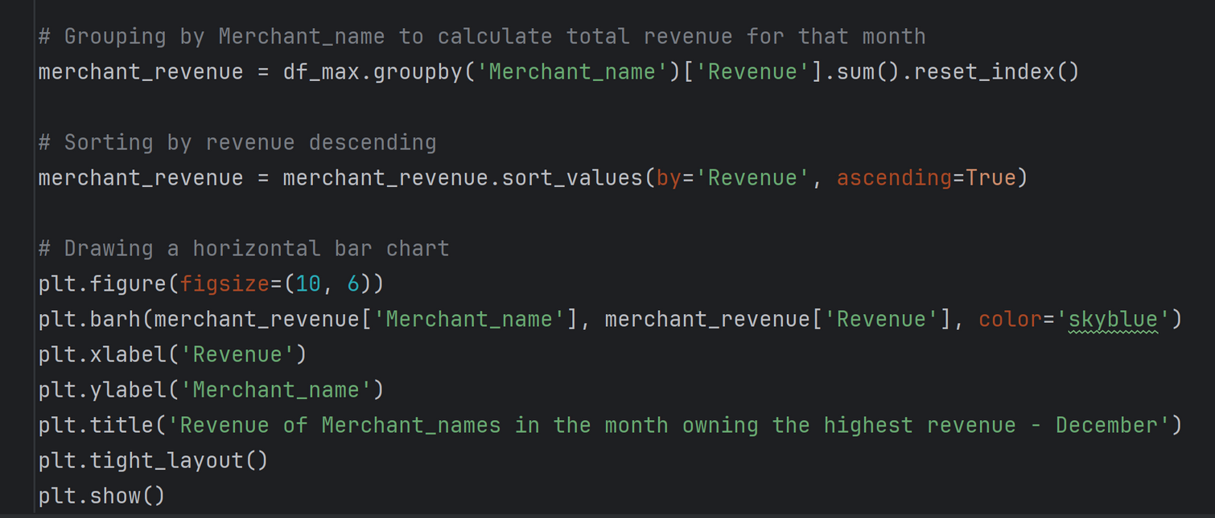
s
Carrying out requirements asked by the topic
Part B: Data Visualization
Draw a bar chart showing the total revenue of Merchant_names in the month with the highest revenue -December

Slide 55
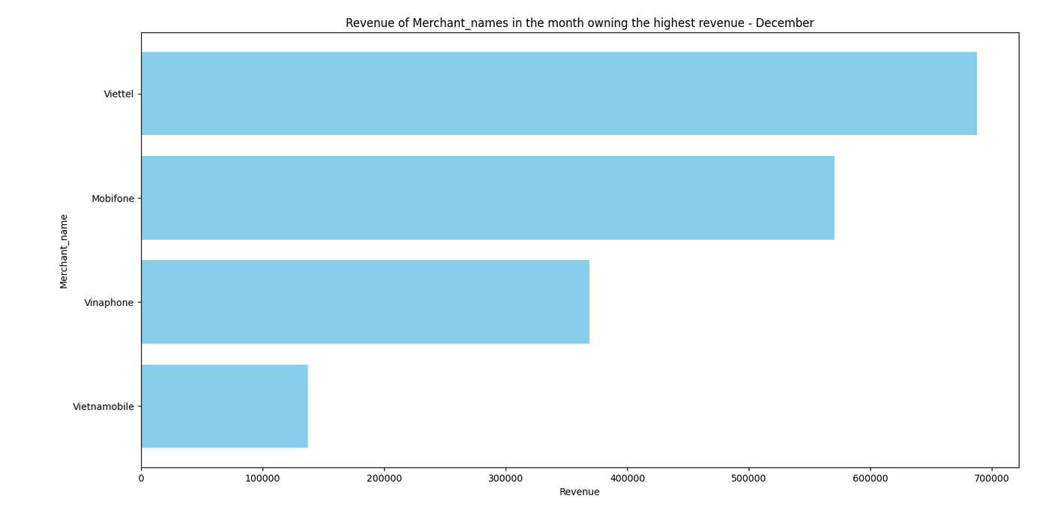
s
Part B: Data Visualization
Carrying out requirements asked by the topic
Drawing a bar chart showing the total revenue of Merchant_names in the month with the highest revenue -December
=> RESULT:

Slide 56
3. Appling Linear Regression Model to train and predict on Revenue column

Slide 57
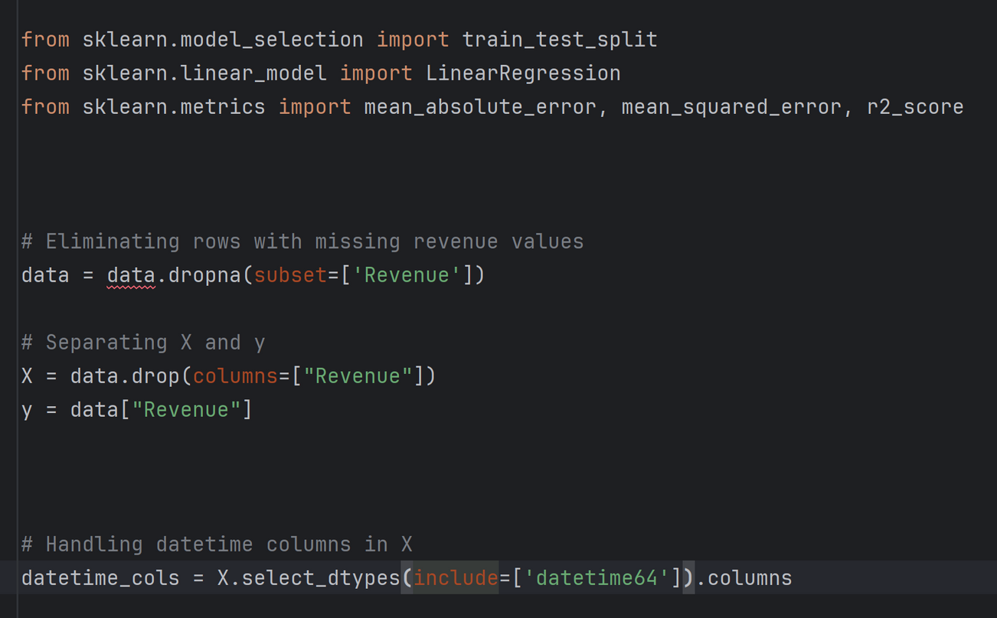
s
Appling Linear Regression Model to train and predict on ‘Revenue’ column

Slide 58
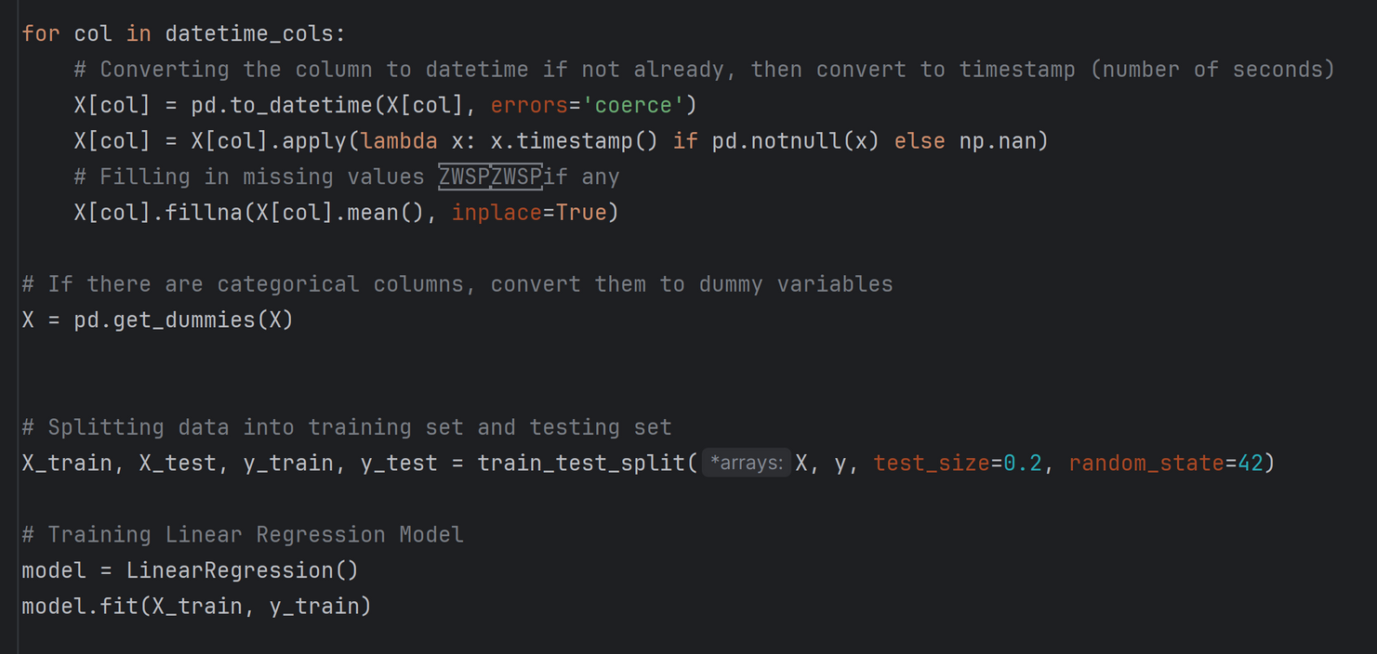
s
Appling Linear Regression Model to train and predict on ‘Revenue’ column

Slide 59
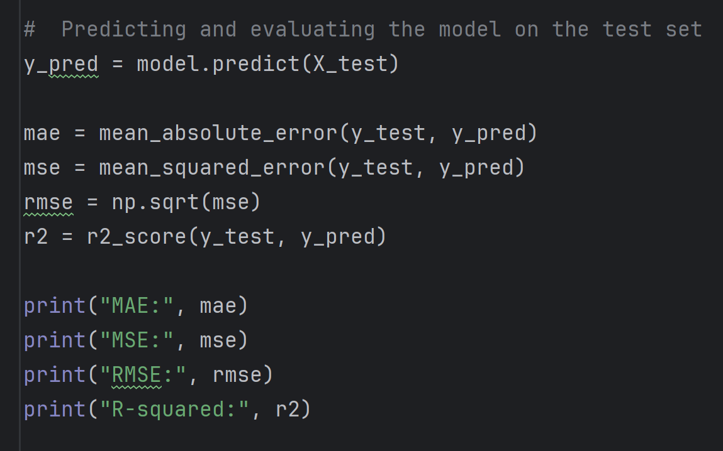
s
Appling Linear Regression Model to train and predict on ‘Revenue’ column

Slide 60
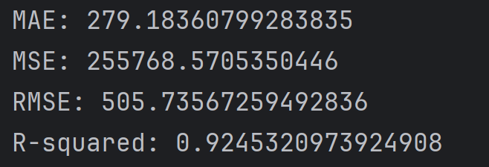
s
Appling Linear Regression Model to train and predict on ‘Revenue’ column
=> RESULT:

Slide 61
III. Conclusions and learnt lessons

Slide 62
Observations and insights that we draw about user demographics and transaction behavior

Slide 63


Demographic
Gender: Male (~50–55%) and female (~45–50%) are fairly balanced, with males slightly more.
Age: 20–35 years old is the majority (~60–70%), 35–50 (~20–25%), over 50 (~10–15%).
Location: HCMC (~36% of revenue), "Other Cities" (~52%), Ha Noi (~12%)
New/old users: >90% are old users, highest new users in March (112), lowest in June (62).

Slide 64
Transaction behavior
Amount: 10,000–20,000 VND accounts for 62.8%, 100,000+ VND is usually "Buy on behalf of".
"Buy on behalf of": 18–31% of transactions, higher on average (122,912 VND vs. 26,108 VND self-purchase).
Network operators: Viettel (44%), Mobifone (38%) lead, accounting for 82% of revenue.
Monthly trend: December is highest (1,764,400 VND, 1,305 transactions), followed by October and July.
Frequency: ~1.01–1.06 transactions/person/month, slightly increasing during peak months.

Slide 65
Key Insights
Demographics: Young adults (20–35) in HCMC and smaller cities are the backbone, with steady use from older users (>50).
Behavior: Small top-ups dominate daily use, but "Mua hộ" drives revenue spikes. Viettel and Mobifone lead, with Dec and Oct as peak months.

Slide 66
Advices for the Marketing department in designing promotion campaigns to increase Topup's monthly performance

Slide 67
Advice for Marketing Department
Cooperation with gaming businesses (topping up games via Momo will be cheaper and more incentives)
Promote "Buy on behalf": "Free top-up" campaign before Tet, for example: "Buy 50,000 VND, get 5% cashback."
Viettel/Mobifone cooperation: Exclusive deal: "Top up Viettel via MoMo, add 2% value."
Increase in December: Loyalty program: "Top up 5 times in December, get 10,000 VND."
Attract people >50: Simplify the application, SMS/community instructions: "Easy top-up for the elderly."

Slide 68
The impacts of MoMo from the customer's perspective and the business perspective

Slide 69
*The customer's perspective:
*Advantage: Increasing the cashback level will create attraction and competition with other e-wallets on the market.
*Disadvantages: Causing other networks to be affected by MoMo top-up sales.

Slide 70
*The business perspective (MoMo)
*Advantage: Increase competitive advantage, help MoMo retain current users and attract new users.
*Disadvantages: Risk of creating a cashback war, leading to long-term costs in marketing

Slide 71
Advices for detucting a part of revenue to increase cashbback for users
The goal is to grow market share and number of users rapidly
Marketing and promotion budget is still guaranteed

Slide 72
Suggesting other development strategies for MoMo's Top-up service
Personalize cashback offers based on transaction history and user behavior.
Customer group offers: Special offers for students, office workers, or customer groups who regularly top up by network.
Collaborate with network operators to launch exclusive promotional packages: For example, preferential data packages when topping up via MoMo.
Creative and engaging communication campaigns on social media platforms such as TikTok, Facebook, Instagram to increase brand awareness and appeal of the cashback program.

Slide 73
THANK
YOU

